Slide 1
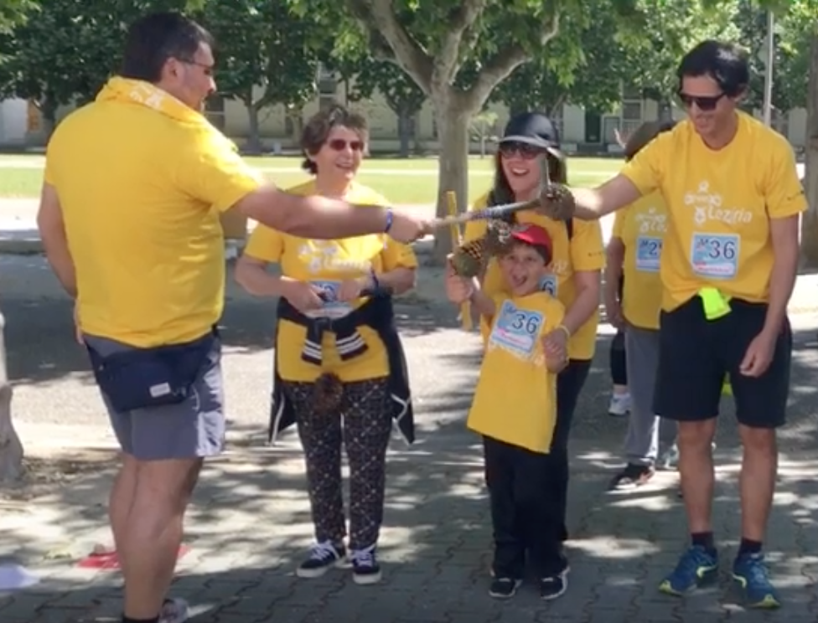
My Right to Play Traditional games
Students from the course of TeSP Acompanhamento de Crianças e Jovens da Escola Superior de Educação de Santarém – Portugal.
For the project: http://me-you-us.eu

Slide 2
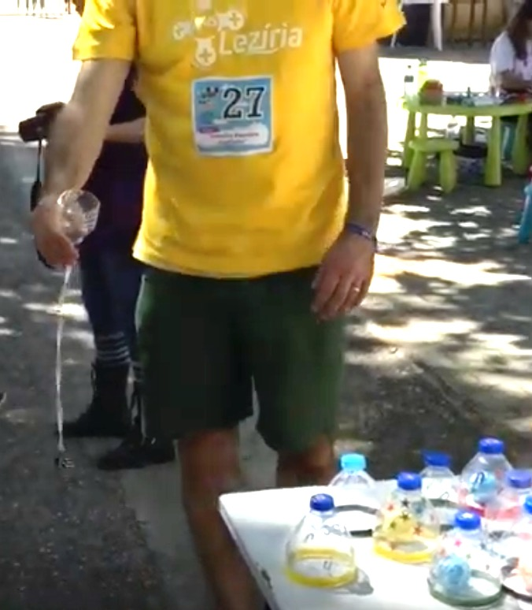
Game 1 - Ball in the Cup
Number of participants:
As many as you like. If they are a lot, more space is needed.
Material:
One bottle cut in half (hoop) for each player;
One ball for each player.
Goal:
Aim at the hoop with the ball and put it inside the hoop.
Description:
Participants must perform movements with only one hand so as to aim at the hoop and put it inside.

Slide 3
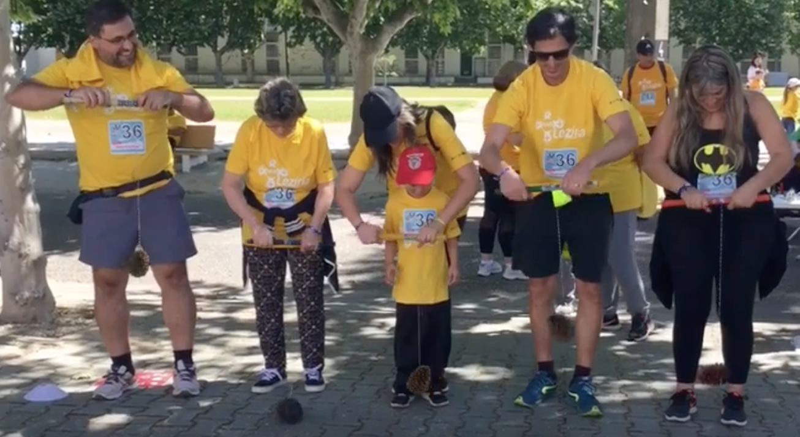
Game 2 – Pinecone Game
Number of participants:
2 or more.
Material:
Wood stick;
Thread;
Pinecone.
Goal:
Be the fastest to wind (roll up) the thread.
Description:
With the pinecone and the wood stick attached by a thread, participants should wind (roll up) the thread as fast as they can. The winner is the first to finish.

Slide 4
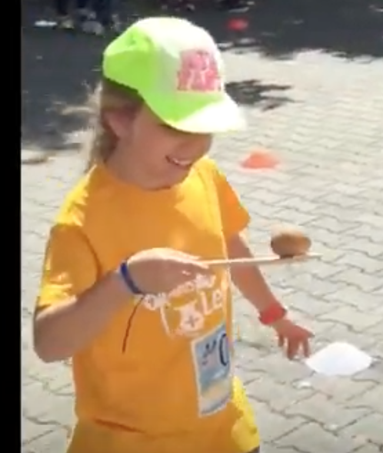
Game 3 - Egg Game
Number of participants:
2 or more.
Material:
Wooden spoon;
Potatoes. The traditional game is played with eggs, but it is better to use potatoes instead to be more sustainable.
Goal:
Be the first to reach the goal without dropping the potato.
Description:
Participants should put themselves side by side at the starting line and balance the potato in the spoon. After a signal they must travel the route to the goal as fast as they can but without letting the potato fall. If it falls, they have to pick it and go back to the starting line and start again.

Slide 5
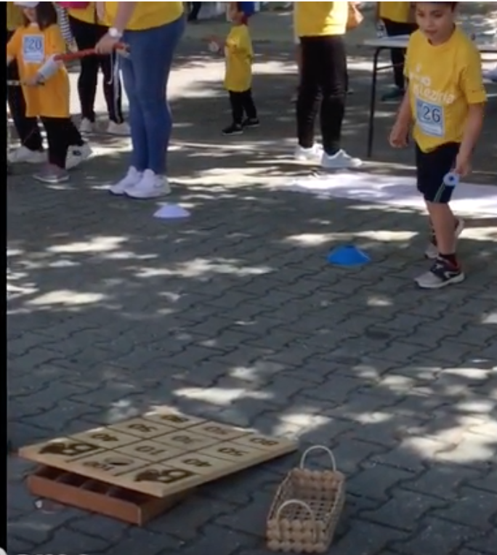
Game 4 - Donkey Game
Number of participants:
4 or more (2 to 2).
Material:
Rectangular wood structure with points and donkey image at the top with a hole;
Meshes (flattened metal rings).
Goal:
Get higher score.
Description:
The participants stand at a distance of about 2 to 3 meters, from where they throw small metal meshes, aiming to hit the houses with the highest score. There is the possibility to make 2 teams in 2 lines perpendicular to the game wood structure. One participant of each team plays at the same time, one after the other. If a player hits the donkeys's image, he/she loses all points he/she already has already. If the meshes hits the line of two different houses, you can decide to count the highest score, the lowest score or not count anything.

Slide 6
Digital tool done by:
Andreia Silva
Joana Pereira
Mariana Garcia
Mariana Pedro
Natacha Alendouro

